Slide 1
Tree
Prepared By:
Afsana Begum
Lecturer,
Software Engineering Department,
Daffodil International University.

Slide 2
Contents
Nature View of a Tree
Data Structure tree
Definition of Tree
Various terms of a tree
Tree Representation
Tree Orders

Slide 3

Nature View of a Tree
leaves
branches
root

Slide 4

Computer Scientist’s View
root
leaves
branches
nodes

Slide 5
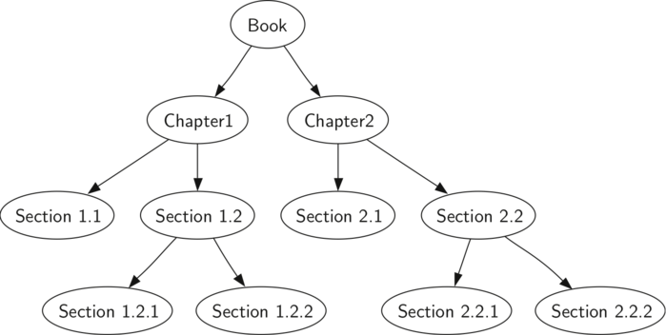
Data Structure tree

Slide 6
Definition of Tree
A tree is a non empty finite set of one or more nodes such that:
There is a specially designated node called the root.
The remaining nodes are partitioned into n>=0 disjoint sets T1, ..., Tn, where each of these sets can be a tree.

Slide 7
Various terms of a tree
Root
Parent child
Parent node
Child
Siblings
Leaf
Level
Sub tree (Minimum one parent and one child)
Degree (Total number of subtree in a tree)

Slide 8
Root: In a tree data structure, the first node is called as Root Node. Every tree must have root node. We can say that root node is the origin of tree data structure. In any tree, there must be only one root node. We never have multiple root nodes in a tree.
Parent child: Child of root and also parent.
Parent node: In a tree data structure, the node which is predecessor of any node is called as PARENT NODE. In simple words, the node which has branch from it to any other node is called as parent node. Parent node can also be defined as "The node which has child / children"
Child: In a tree data structure, the node which is descendant of any node is called as CHILD Node.

Slide 9
Siblings: In a tree data structure, nodes which belong to same Parent are called as SIBLINGS. In simple words, the nodes with same parent are called as Sibling nodes.
Leaf: In a tree data structure, the node which does not have a child is called as LEAF Node. In simple words, a leaf is a node with no child. In a tree data structure, the leaf nodes are also called as External Nodes. External node is also a node with no child.
Level: In a tree data structure, the root node is said to be at Level 0 and the children of root node are at Level 1 and the children of the nodes which are at Level 1 will be at Level 2 and so on.

Slide 10
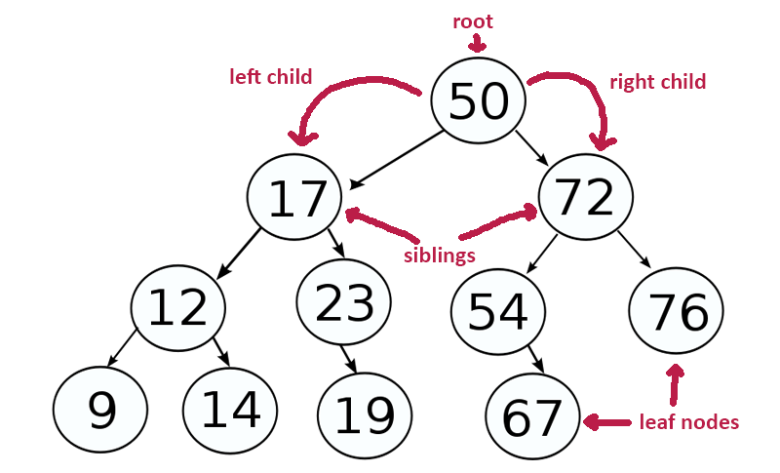
Various terms of a tree
Parent Node
Parent Child
Level

Slide 11
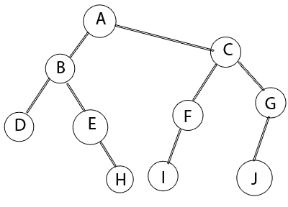
Degree (Total number of subtree in a tree) Here: degree 8 (Draw all 8)

Slide 12
Tree Representation
A(B,C)
A(B(D,E),C(F,G))
A(B(D,E(H)), C(F(I),G(J)))

Slide 13
Tree Orders
Pre Order Tree (Root, Left Child, Right Child)
In Order Tree (Left Child, Root, Right Child)
Post Order Tree (Left Child, Right Child , Root)

Slide 14
Pre Order (ro,L,R)
Pre Order: A,B,D,E,H,C,F,I,G,J

Slide 15
In Order (L,Ro,R)
In Order: D,B,E,H,A,I,F,C,J,G

Slide 16
Post order (L, R, Ro)
Post Order: D,H,E,B,I,F,J,G,C,A

Slide 17
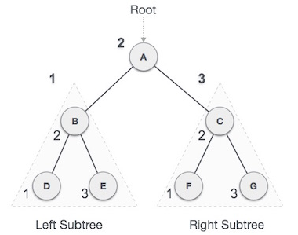

Slide 18
In Order : D → B → E → A → F → C → G
Pre Order: A → B → D → E → C → F → G
Post Order: D → E → B → F → G → C → A

Slide 19
Thank You
Any Question?

